Slide 1

Fundamental Forces in nature
B. Sc- 1th Sem-Electronics
RR BAWA DAV College For Girls, Batala
Prof. Pankaj Kumar
HOD, Physics

Slide 2
The Four Fundamental Forces
Every force is a manifestation of one of the four fundamental forces of nature. They are (listed in order of decreasing strength):
strong nuclear force
electromagnetic force
weak nuclear force
gravitational force

Slide 3
Four Fundamental Interactions
Interaction | Relative Strength | Range (m) | Particle(s) Affected | Exchange Particles | Masses of Exchange Particles (GeV/c²)
strong | 1 | ₁₀-15 _{m} | quarks | gluons (g) | 0
electromagnetic | ₁₀-2 | ∞ | electrically charged | photon (γ) | 0
weak | ₁₀-6 | ₁₀-18 _{m} | quarks and leptons | W⁺, W⁻, Z⁰ | 80.4, 80.4, 91.2
gravitational | ₁₀-43 | ∞ | all | graviton | 0

Slide 4

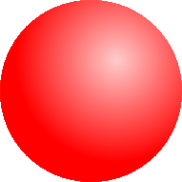
Orders of magnitude
  m: the distance between atoms in a substance.
  m: The size of an atom, and the range of the strong nuclear force.
10⁻¹⁸ m: The range of the weak nuclear force.
₁₀-14 _{m}
₁₀-15 _{m}
.
smaller than this dot ₁₀−18 _{m}

Slide 5
The strong nuclear force
is a very strong, attractive short-range (10⁻¹⁵ m) force that binds the protons and neutrons in the nuclei of atoms together. It is the strongest of the fundamental forces, but acts over a very short distance (10⁻¹⁵ m).
The strong force is what binds quarks in combinations so they can form protons and neutrons and many more exotic subatomic particles.

Slide 6


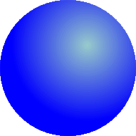

Quarks
are a family of fundamental particles that comprise various types of matter, including protons and neutrons. Because of the strong force, quarks are always bound to other quarks.
A proton consists of two “up” quarks and a “down” quark, while a neutron consists of two “down” quarks and an “up” quark.
proton
neutron

Slide 7
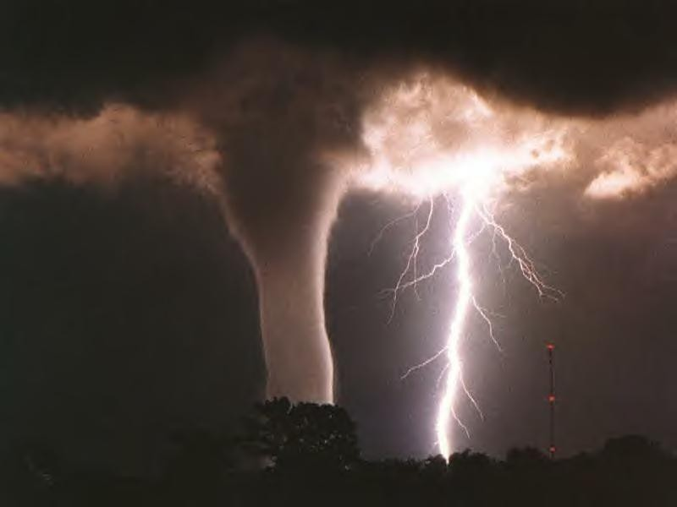
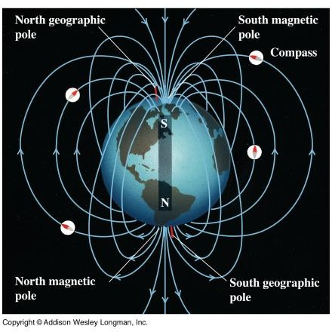
The electromagnetic force
is a very strong, long-range force with unlimited range that acts between any two objects possessing an electric charge. It is the fundamental interaction that binds electrons to nuclei to form atoms and binds atoms together in molecules and solids.

Slide 8


The electric force,
an aspect of the electromagnetic force, is either attractive or repulsive depending on whether the charges involved are positive (+) or negative(-).
Two positive charges will repel each other
Two negative charges will repel each other
A positive and a negative charge will attract each other.

Slide 9
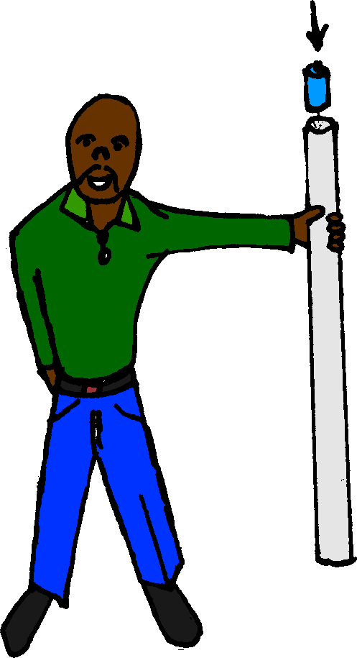
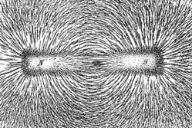
The magnetic force,
an aspect of the electromagnetic force, is either an attractive or a repulsive depending on the interaction of the magnetic fields between two charged objects.
Two magnetic north poles will repel each other
Two magnetic south poles will repel each other
A magnetic north and a magnetic south pole will attract each other.

Slide 10
The weak nuclear force
is an extremely short-range (10⁻¹⁸ m) force that acts on the quarks that make up protons and neutrons.
It is much weaker than the electric and the strong forces (but still much stronger than gravity at short distances), acts over an extremely tiny distance, and is the cause for beta decay in atoms.
Without it, the sun would not shine because it allows protons to change into neutrons, allowing for nuclear fusion.

Slide 11
Radioactivity – alpha decay
alpha particle
Electric forces try to break the nucleus apart, while the strong nuclear force tries to bind the nucleus together.
In larger atoms, the electric force of repulsion may break the nucleus apart, resulting in a form of radiation called alpha decay.
parent nucleus
daughter nucleus

Slide 12
Radioactivity – beta decay
proton
The weak nuclear force is responsible for a form of radioactivity called beta decay. Beta decay occurs when a neutron breaks apart into an electron and a proton. The electron gets kicked out of the nucleus as radioactivity, while the proton remains in the nucleus, changing the original atom into a different element.
neutron
electron

Slide 13
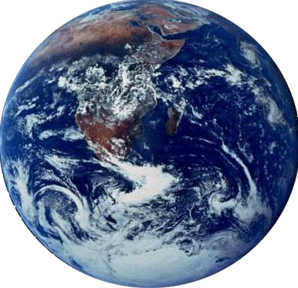
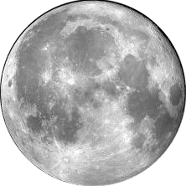


The gravitational force
is a very weak, attractive long-range force of unlimited range that exists between any two objects possessing mass. It is the weakest of all the fundamental forces.
^{F}gEM
^{F}gME

Slide 14
Thanks

